Slide 1
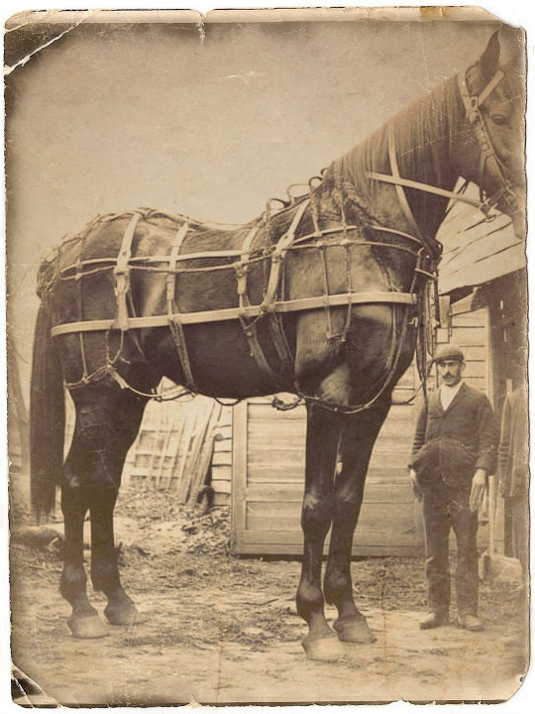
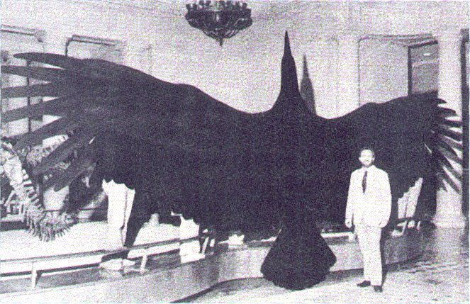
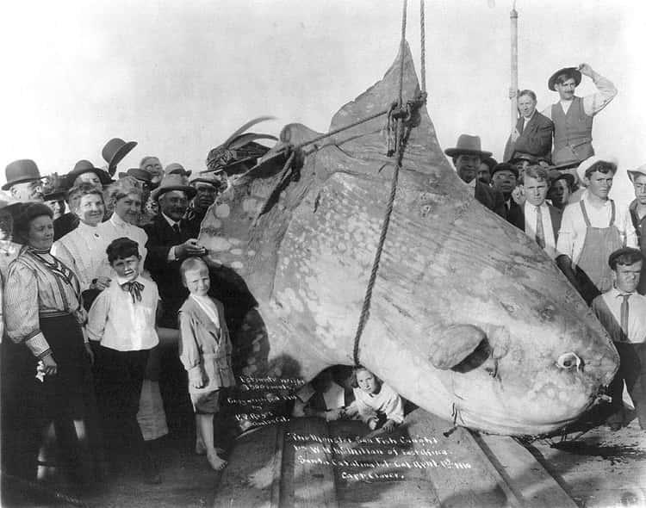

Slide 2
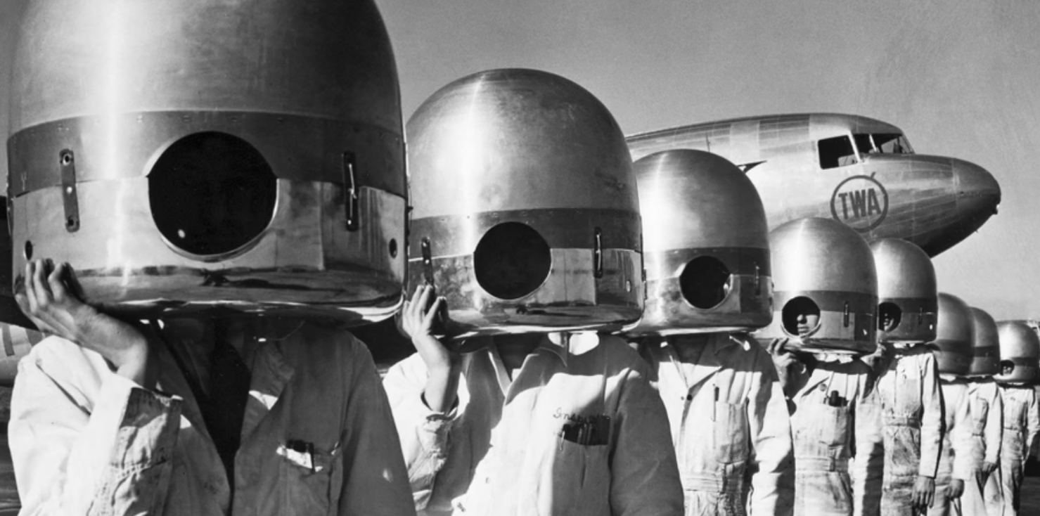
May 8, 1941, New York, La Guardia Field. TWA mechanics and inspectors with propeller hub caps over their heads as they go about spring overhauling chores on the giant transport planes at the airport.
https://www.theatlantic.com/photo/2018/01/weird-wonderful-photos-from-the-archives/551378/

Slide 3
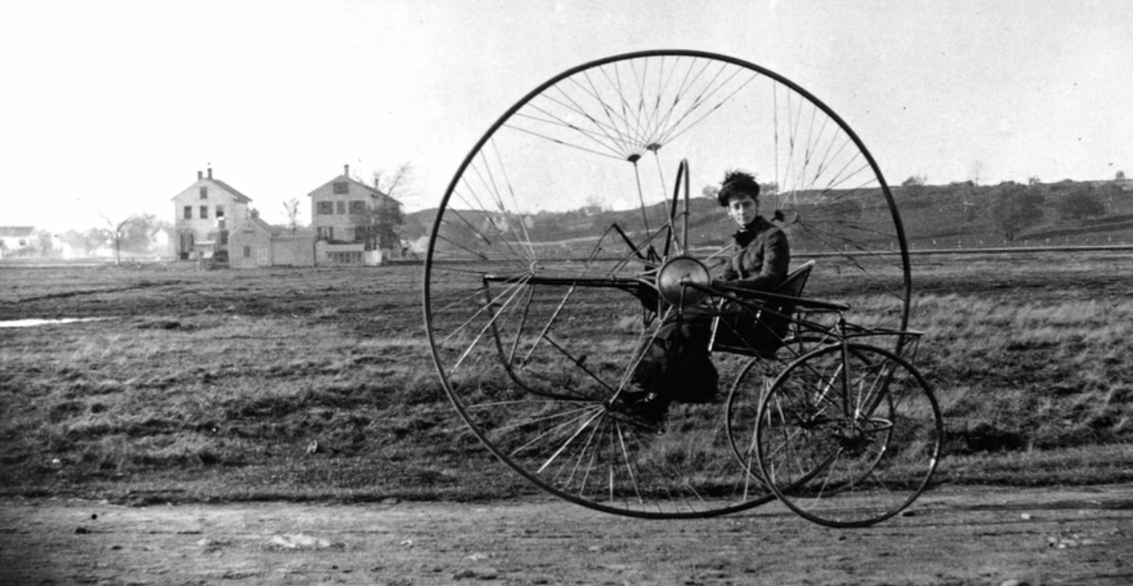
Oldriev's new tricycle. Photo by Chas. W Oldrieve, 1882.
https://www.theatlantic.com/photo/2018/01/weird-wonderful-photos-from-the-archives/551378/

Slide 4
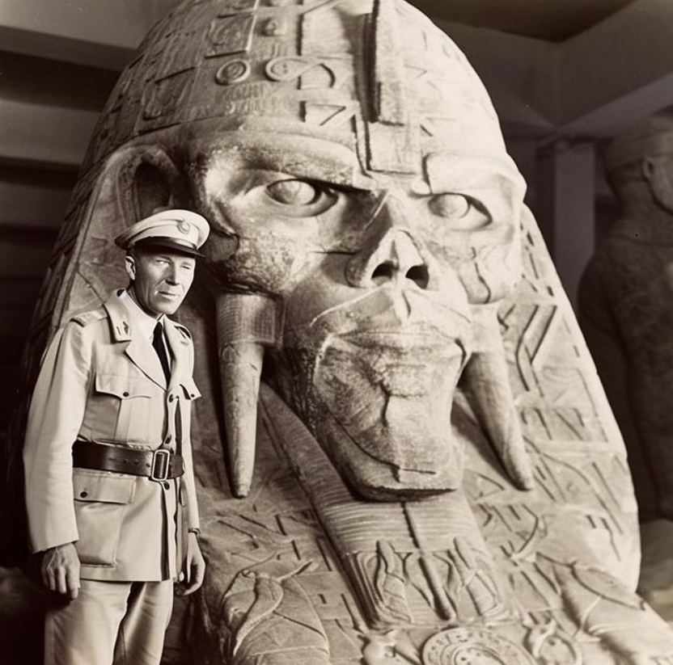
Top-ranking German generals, during their North African campaign, unearthed ancient alien artifacts in Egypt.

